Slide 1
Artificial Intelligence Approach For Filtering Offensive And Hate Comments On Social Media Platforms. GUIDED BY :PROF. MAHENDRA MEHERA
AARON DOMINGO(8763)
AADARSH KSHIRSAGAR(8765)
ADITI PAI(8766)

Slide 2
INTRODUCTION
Isn’t it difficult for user to categorize between positive and negative views on their stream.
The main goal of Text Mining is to enable user to extract information from textual resources.
Text Categorization is main aspect of Text Mining.
Using the prescribed technology, we must intigrate the add-on feature on the social media application.
Text can be written in many genre, genre classification is management of different information which is pre-existant. However in the case of social media texting genre is not a well defined notation
The main motivation is to filter the unwanted comments which are posted on social media networks

Slide 3
LITERETURE REVIEW
The foundation of machine learning deals with representation and generalization.
Representation of data instances and function evaluated on these instances are part of all machine learning systems.
Generalization is the property that the system will perform well on unseen data instances, core objective is the generalize from its experience.
For example, Facebook allows OSN users to state who is allowed to insert messages in their walls (ie, friends of friends, friends or unknowns ), however no content based preferences are maintained and therefore it is not possible to prevent unwanted messages such as political, vulgar or promotional messages, no matter who posts them. The users private wall messages are constituted by short text for which traditional classification methods have serious limitations since short text dont provide sufficient word occurrences.

Slide 4
BACKGROUND
Today one of the most popular interactive medium is Online Social Networks, which is used to communicate with many people to share knowledgeable information, and distribute a considerable amount of human life information.
Every day communications imply the exchange of several types of information including text, image, audio and video data.
Overall statistics of Face book reveals that the average user creates 90 pieces of information in every month, whereas more than 30 billion pieces of information such as news stories, blog posts, notes, web links, and photo album are shared by each month.
Specially as there are no restrictions people just pass on comments and this may have a very bad impact on the other persons mental and well as social health.

Slide 5
PROBLEM STATEMENT
The abusive comments can have a bad impact on a person's mental health and even it can affect one's career.
There are also a unnecessary spamming of the comment section with self-promotional and influencing type comments.
The solution to this can be filtering our comments and deleting the abusive and influencer types of comments.
Instead of manually deleting the comments the model will do it on users behalf.

Slide 6
OBJECTIVES
Working with social media APIs (such as, Instagram Graph APIs)
Fetching Comments using those APIs
Sorting comments and comment IDs in a xlsv file.
Getting the required datasets for the ML model.
Developing an ML model that will filter the person's comments and delete all abusive and inappropriate comments from the post.
Training the developed model by feeding raw data.
Processing the comments and getting the required results.
Deleting the comments and filtering the comment section.

Slide 7
CHALLENGES
The fundamental issues in online social networks (OSN) are preventing unwanted comments which are posted in OSN user’s private wall.
The comments posted in online social network do not have proper word occurrences. That comment consists of short text and non-English word.
Add-on integration on a social media platforms.
Security related to the Add-on feature.
Insufficient knowledge about Machine Learning Approaches.
Working with different social media API’s

Slide 8
EXISTING SYSTEM
As all are familiar working with social media, text classification techniques are used to classify the text, however text can be written in many different genres.
Genres are not well defined notations in technical terms, so therefore we have some text classification techniques such as Decision tree, Nearest Neighbor, Nerual Networks, Rocchio’s Algorithm etc.
Short text classification and long text classification techniques are the canopy for the various text classification techniques.
Basically a set of predefined words or a bag of words are used to classify the text in most techniques.

Slide 9
PROPOSED SYSTEM
We use these same bag of words as datasets and feed it into the ML model.
An algorithm is used to filter the texts or comments efficiently, unwanted comments posted by the OSN users are classified using ML approach.
Each comment can be identified by a unique comment id.
The user then can delete the comments manually or then choose a auto-delete option.
This entire system will be an add-on to the existing applications and with little modification can be used on any social media platform.

Slide 10
TECHNOLOGY USAGE
Programming Language :Python.
Libraries: Numpy , Pandas, Scikit-learn.
Tools :Jupyter notebook/Atom
Algorithm: Machine Learning Algorithm
API: Instagram Graph API

Slide 11
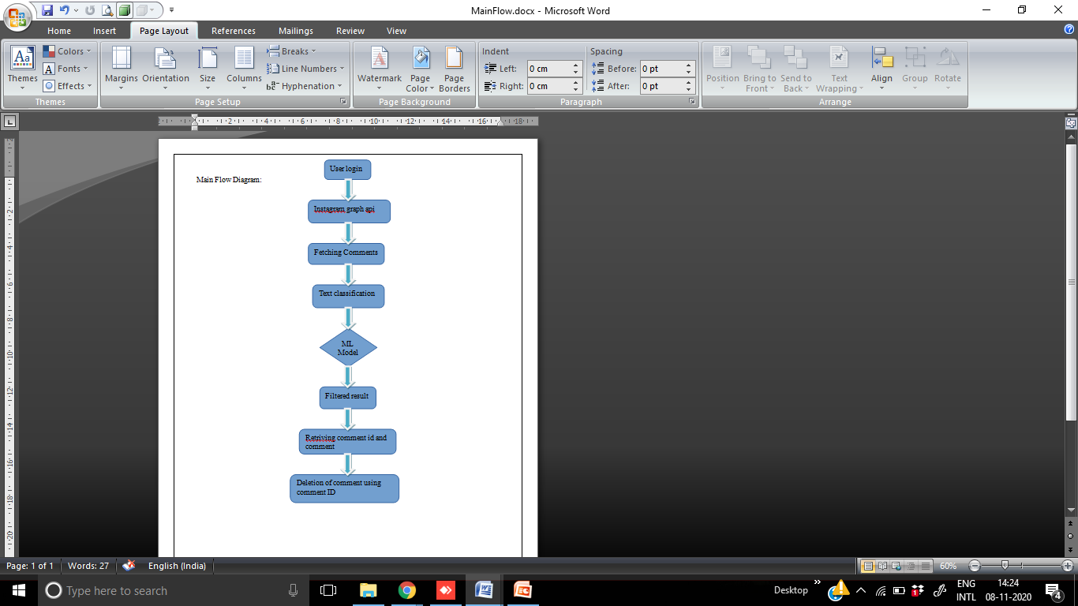
Main Flow Diagram

Slide 12
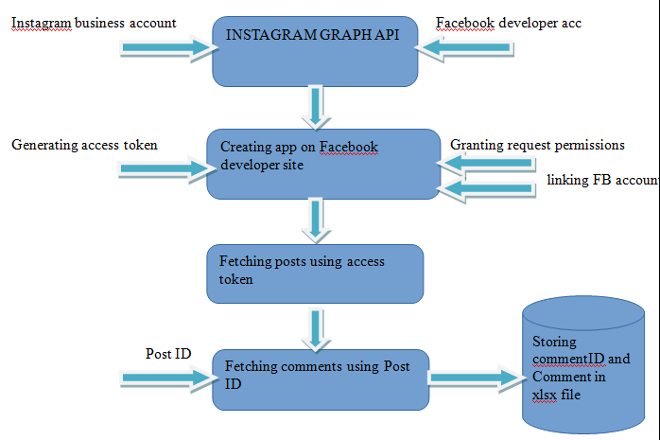
Instagram Graph API

Slide 13
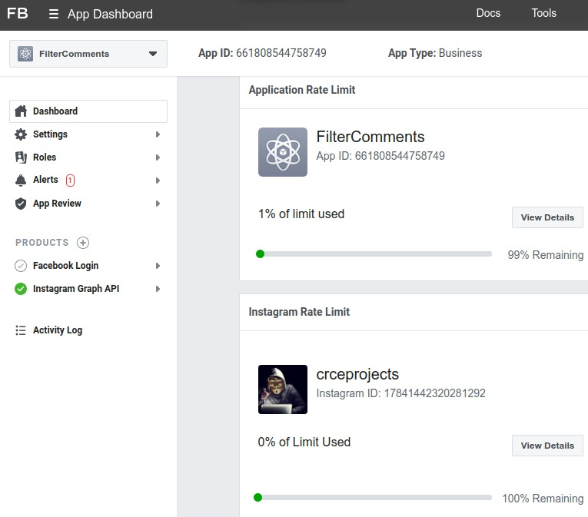
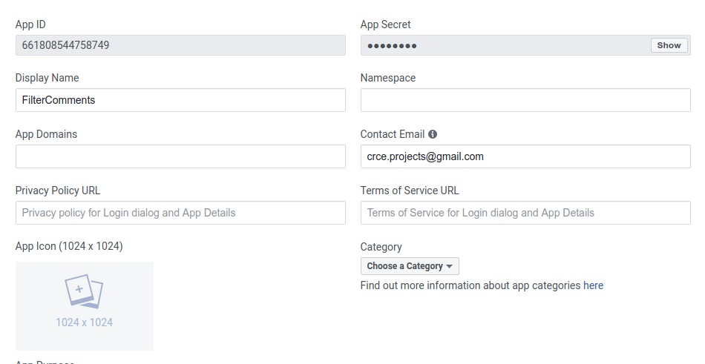
Instagram Graph API

Slide 14
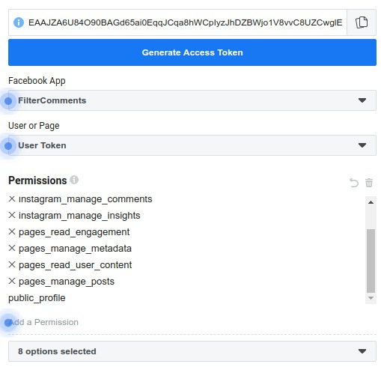
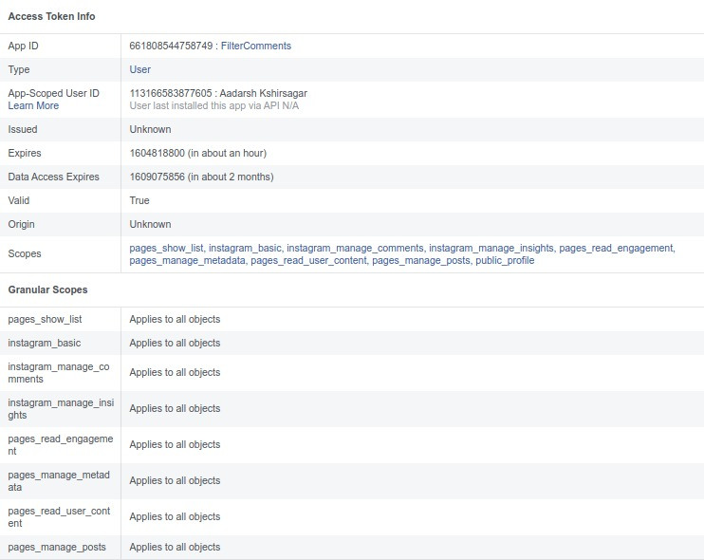
Instagram Graph API

Slide 15
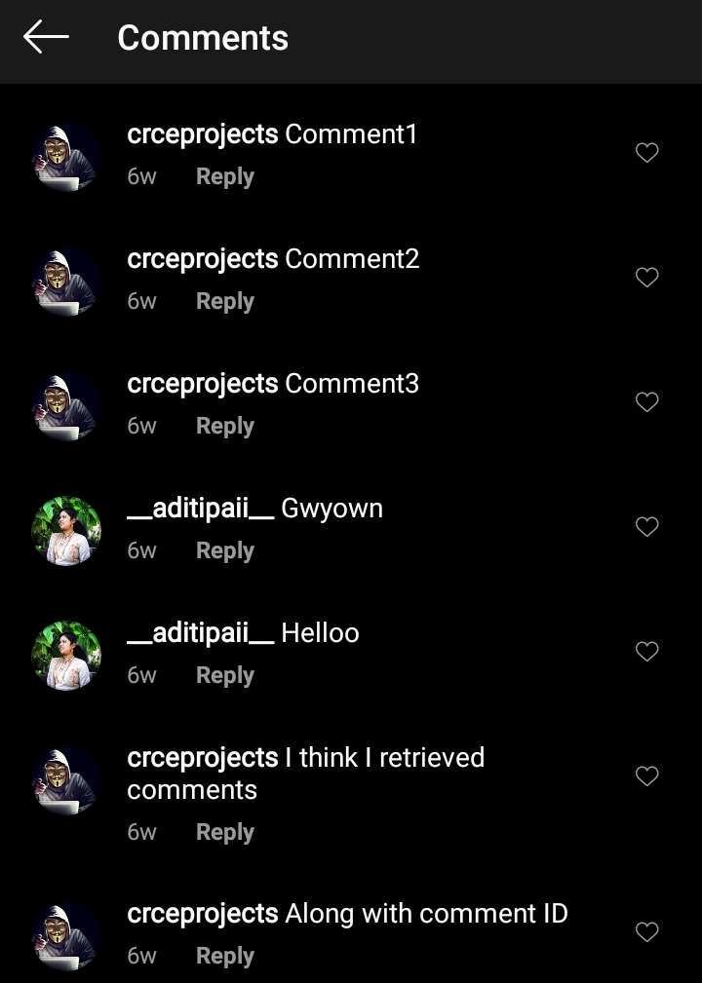
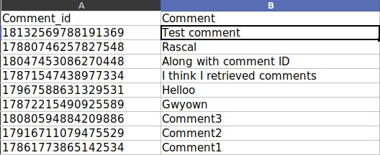

Instagram Graph API
We have successfully fetched the comments form a post in the Instagram account and stored it in a .xlsx file.
These comments will be given into the ML model as input.

Slide 16
IMPLEMENTATION PLAN FOR NEXT SEMESTER.
We will be adding Machine learning model to filter the comments automatically.
Algorithm used will be “AdaBoost Algorithm”.

Slide 17
REFERENCES
https://www.coursera.org/learn/machine-learning
http://ijarcst.com/doc/vol2-issue2/gparvathi.pdf
https://www.coursera.org/learn/web-development
https://www.agorapulse.com/blog/hide-comments-on-facebook/
https://youtu.be/yebUIymZJm0

